Slide 1


Slide 2
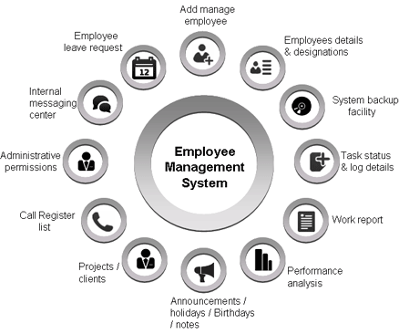
INTRODUCTION
Full Stack Application – EMPLOYEE MANAGEMENT
Employee Management System is a distributed application, developed to maintain the details of employees working in any organization. It maintains the information about the personal details of their employees, also the details about the payroll system which enable to generate the payslip. The application is actually a suite of applications developed using Java.
It is simple to understand and can be used by anyone who is not even familiar with simple employees system. It is user friendly and just asks the user to follow step by step operations by giving him few options. It is fast and can perform many operations of a company.

Slide 3
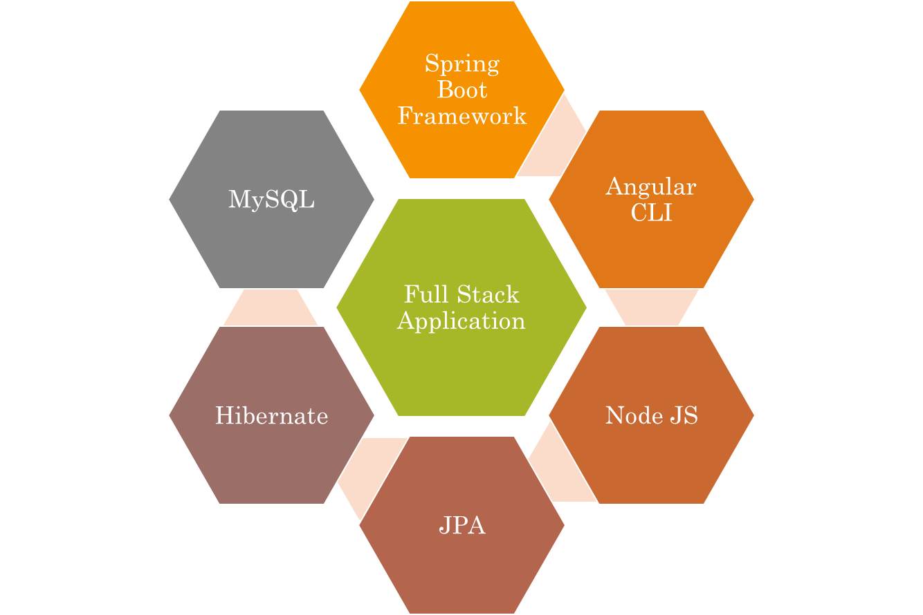
Technologies used.

Slide 4
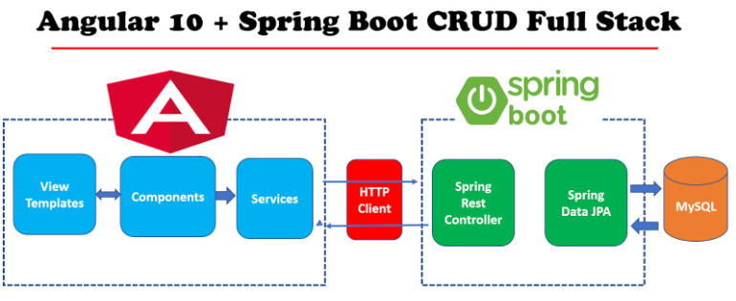


The Architecture of Angular, Spring
& database(MySQL)

Slide 5
The Architecture of the Project
Angular JS
Node JS
Frontend
Spring Boot
Backend
MySQL

Slide 6
CRUD Operations
View
Update
Delete
Create
Add Employee

Slide 7
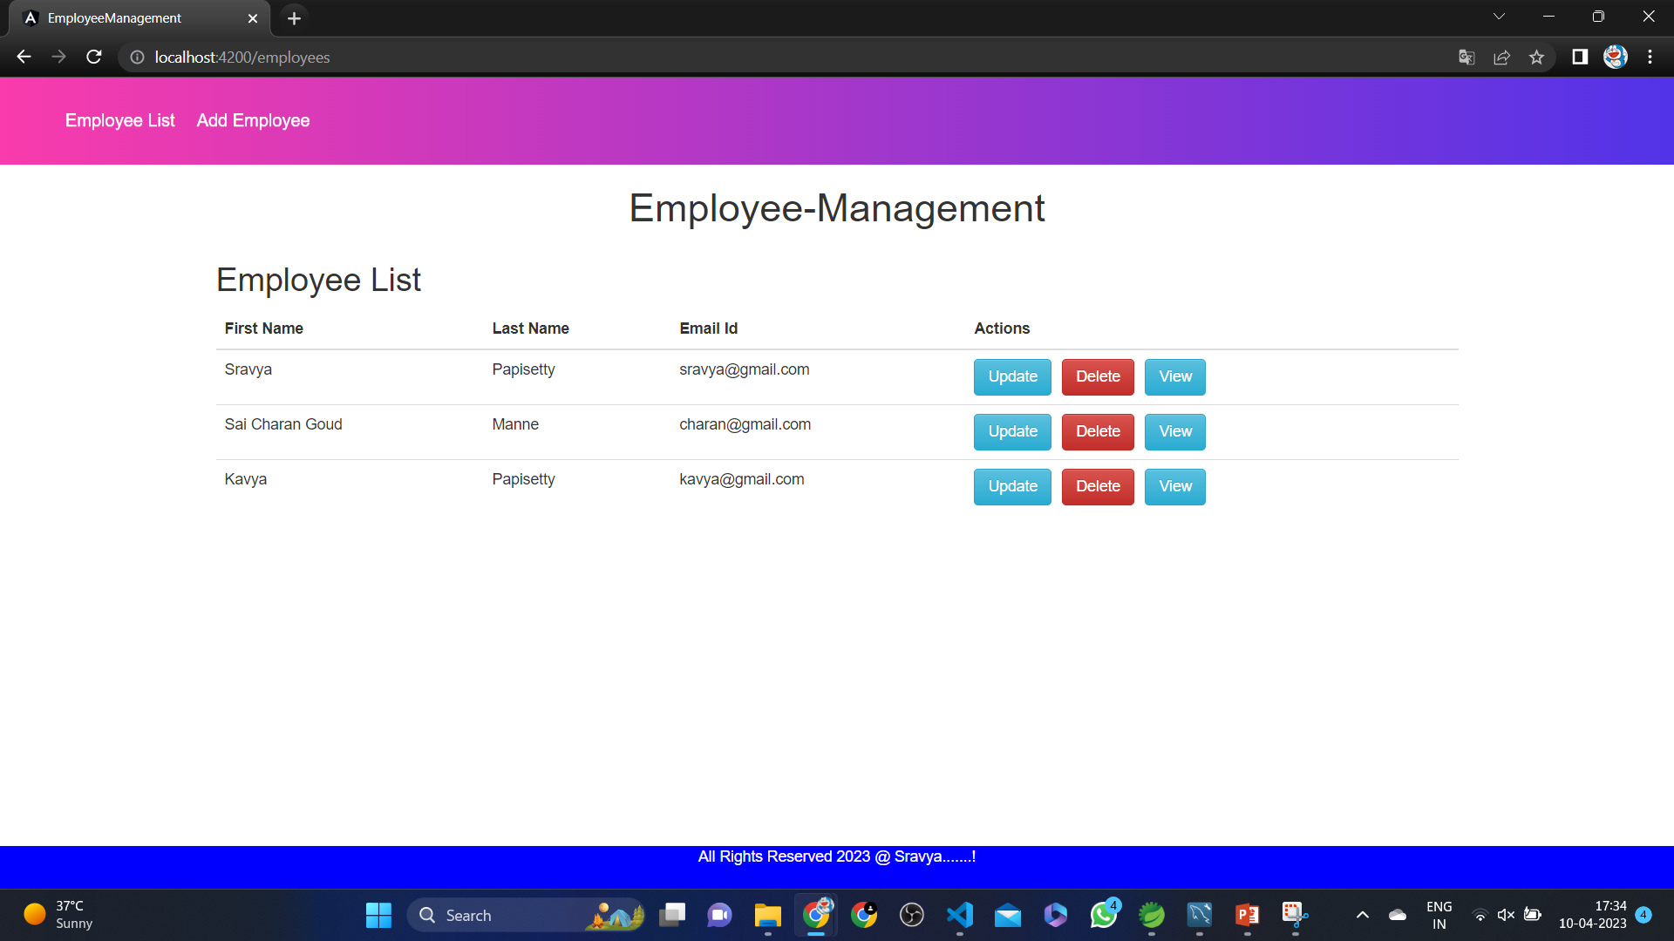
Home Page

Slide 8
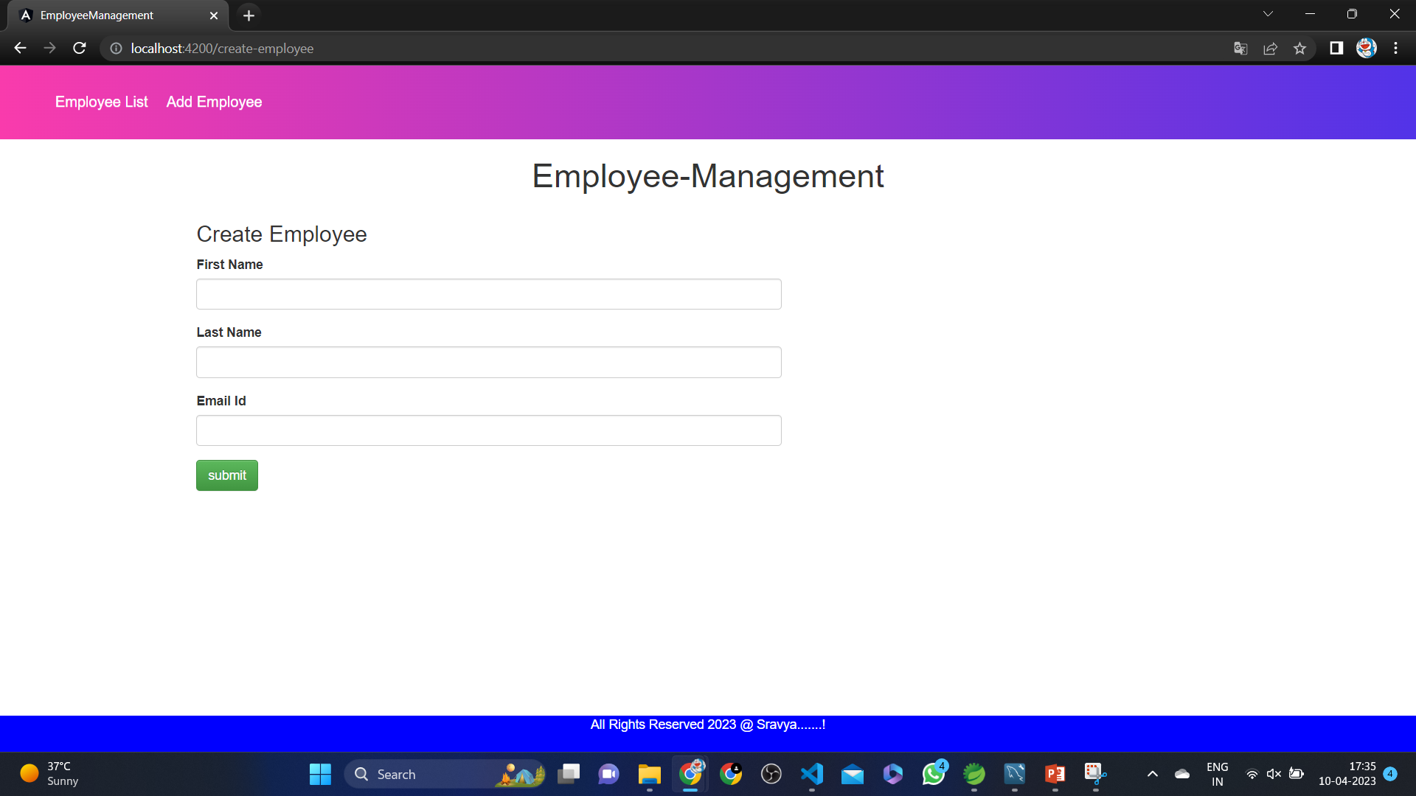
Create Employee

Slide 9

Delete Employee

Slide 10
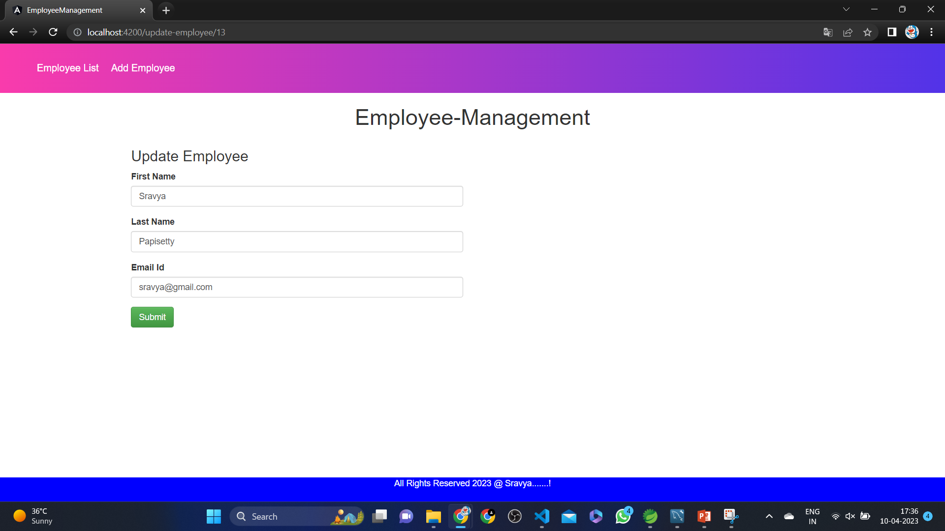
Update Employee

Slide 11
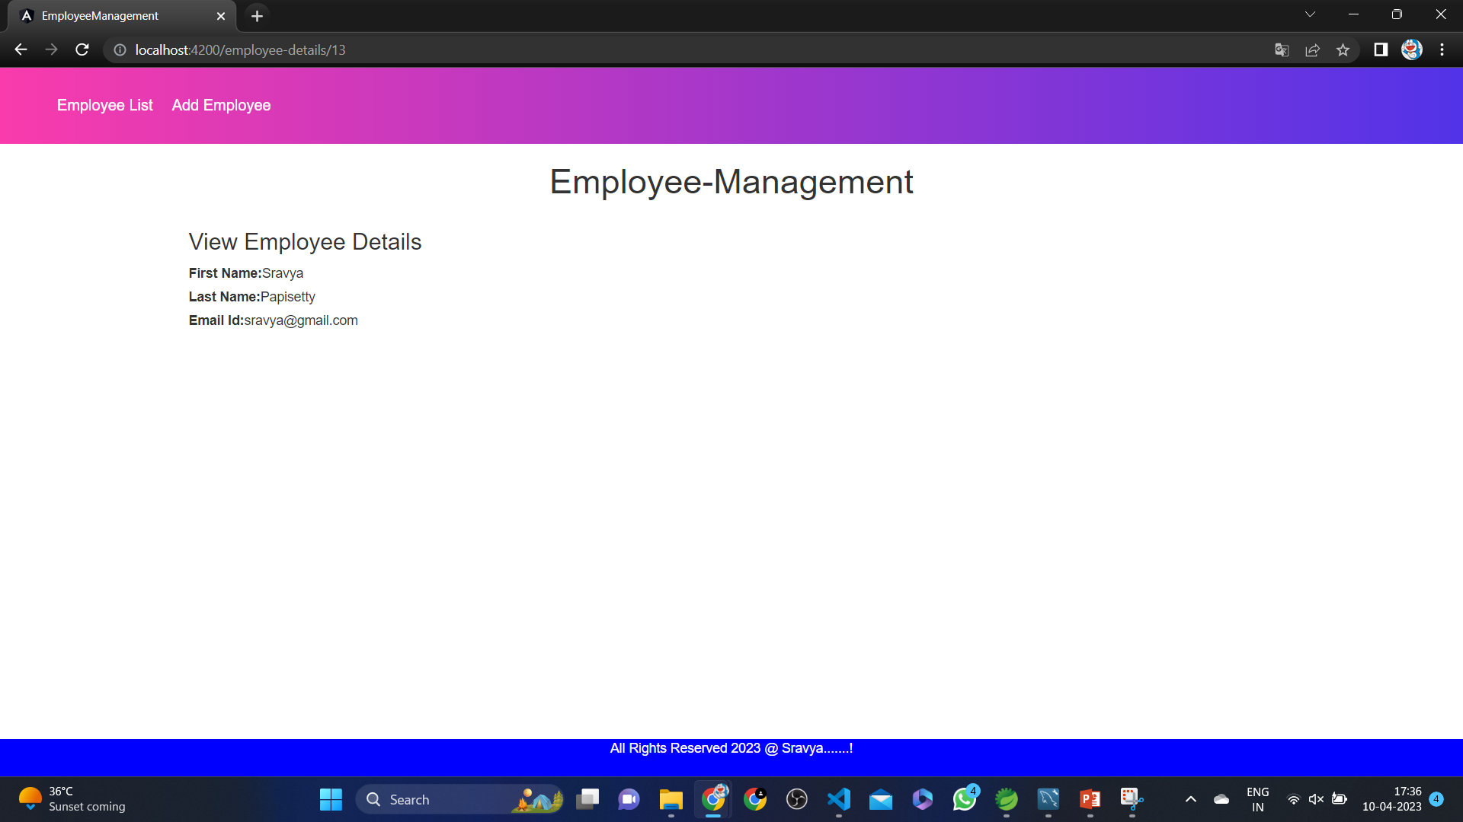
View Employee

Slide 12
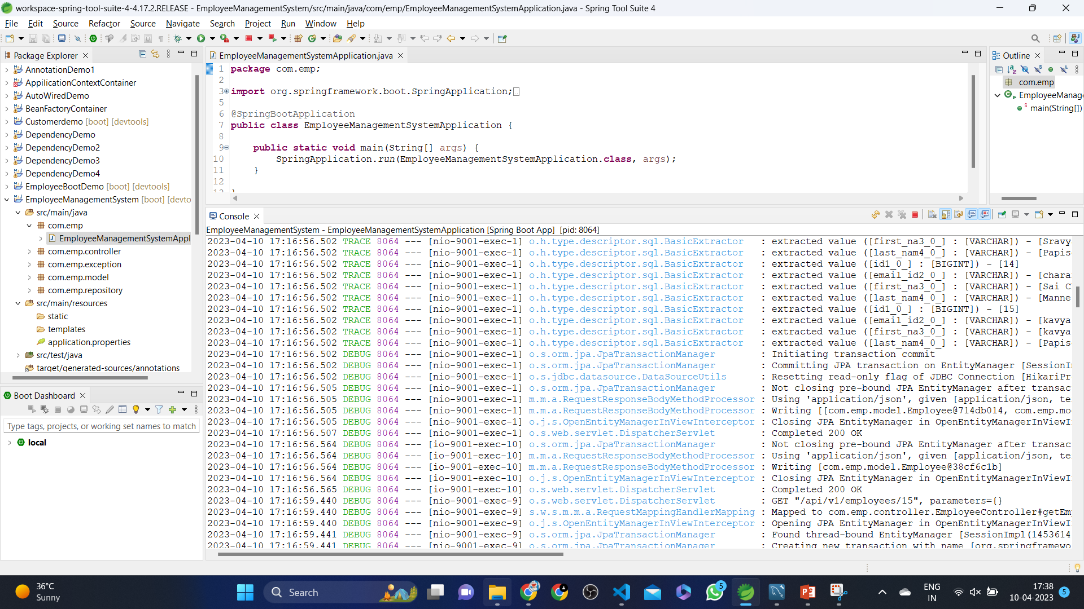
Spring Boot Application

Slide 13
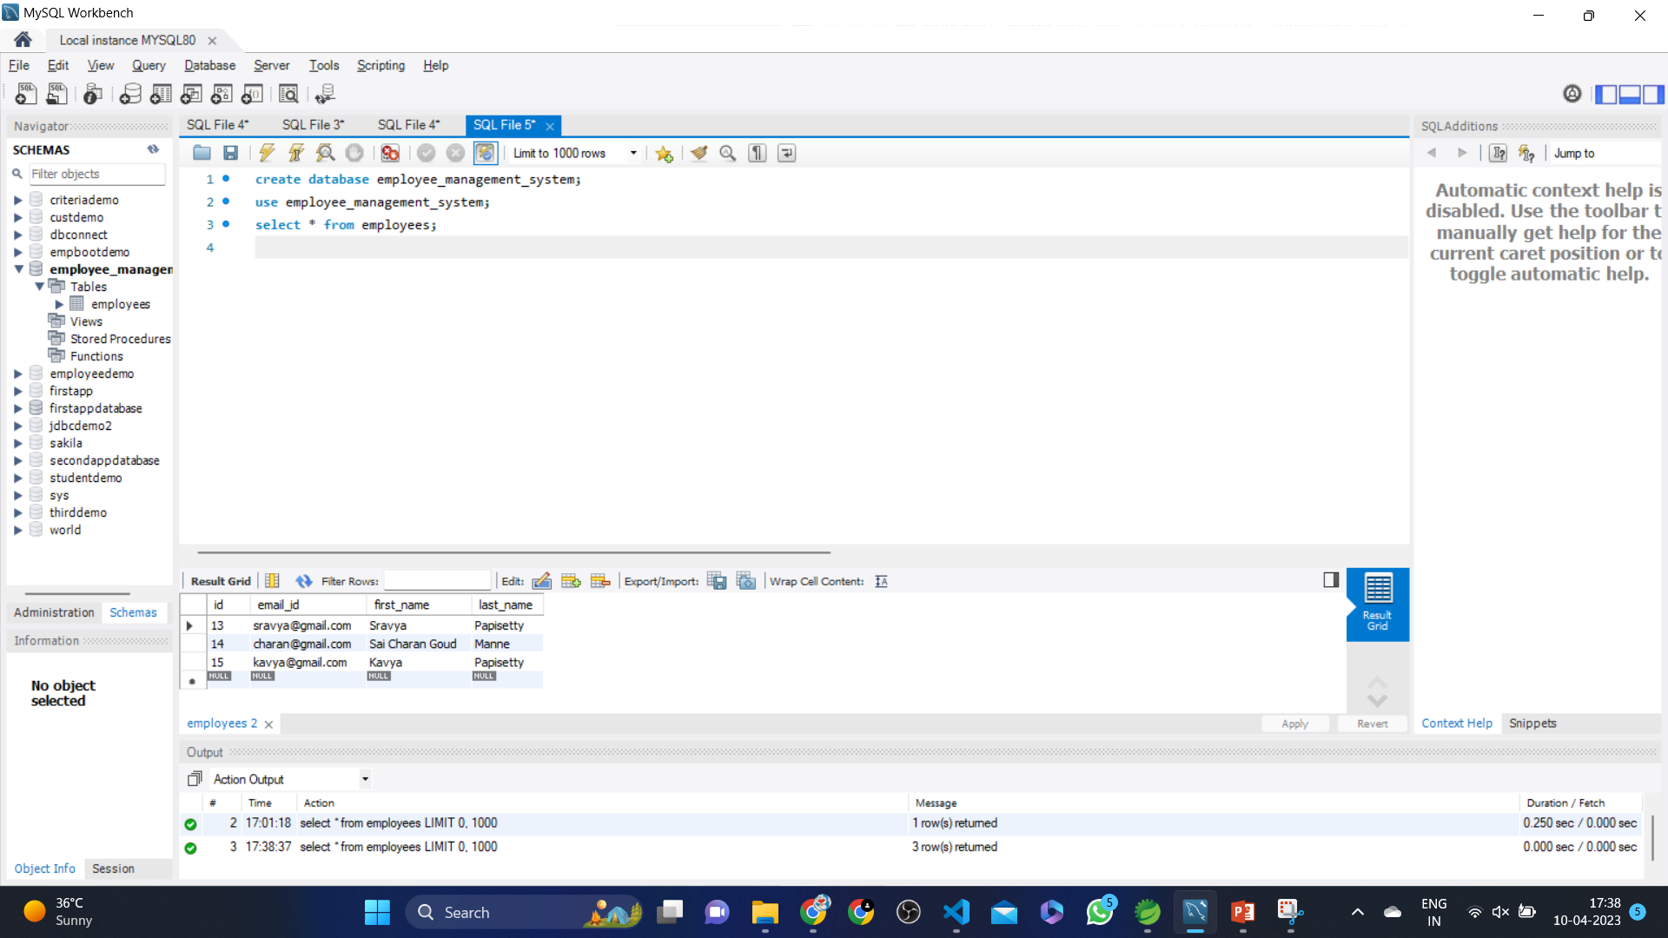
MySQL Code

Slide 14
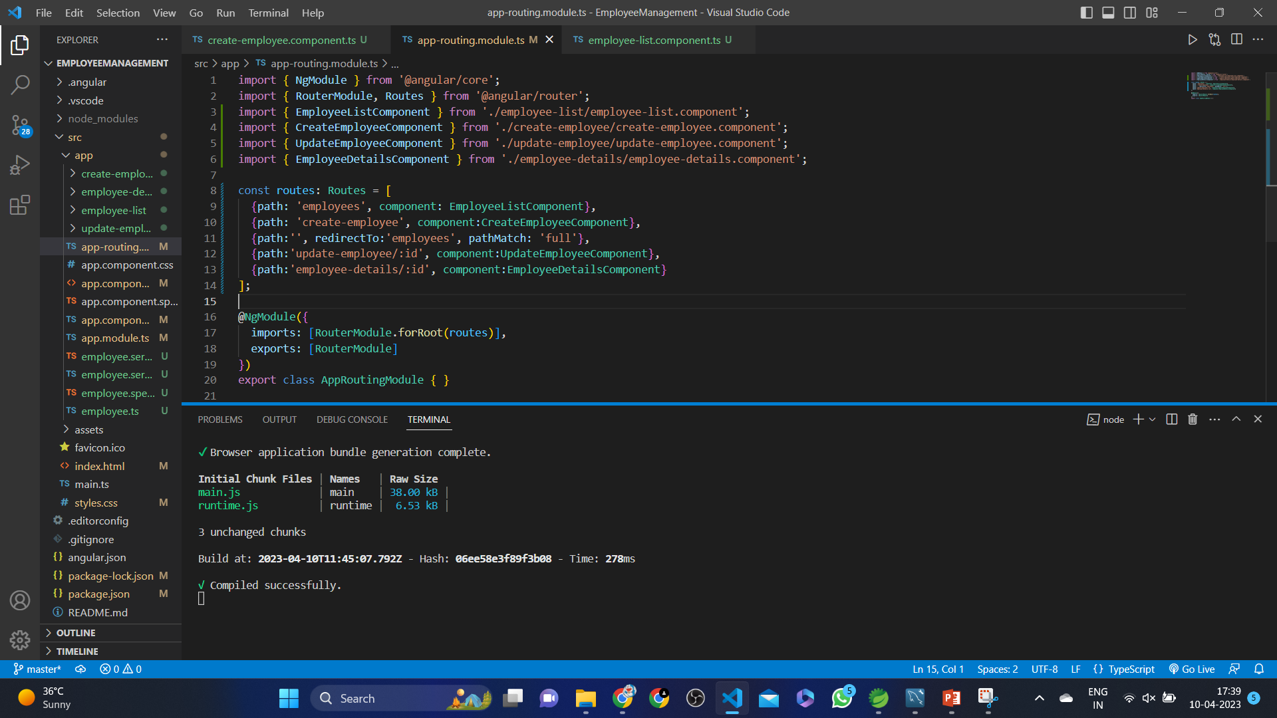
Frontend – Angular JS

Slide 15
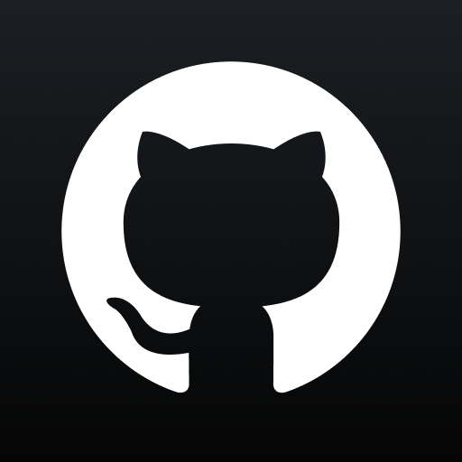
GitHub Link

Slide 16

Thank you.

